Slide 1
Energy and Climate Change
Chapter 5
The Greenhouse Effect

Slide 2
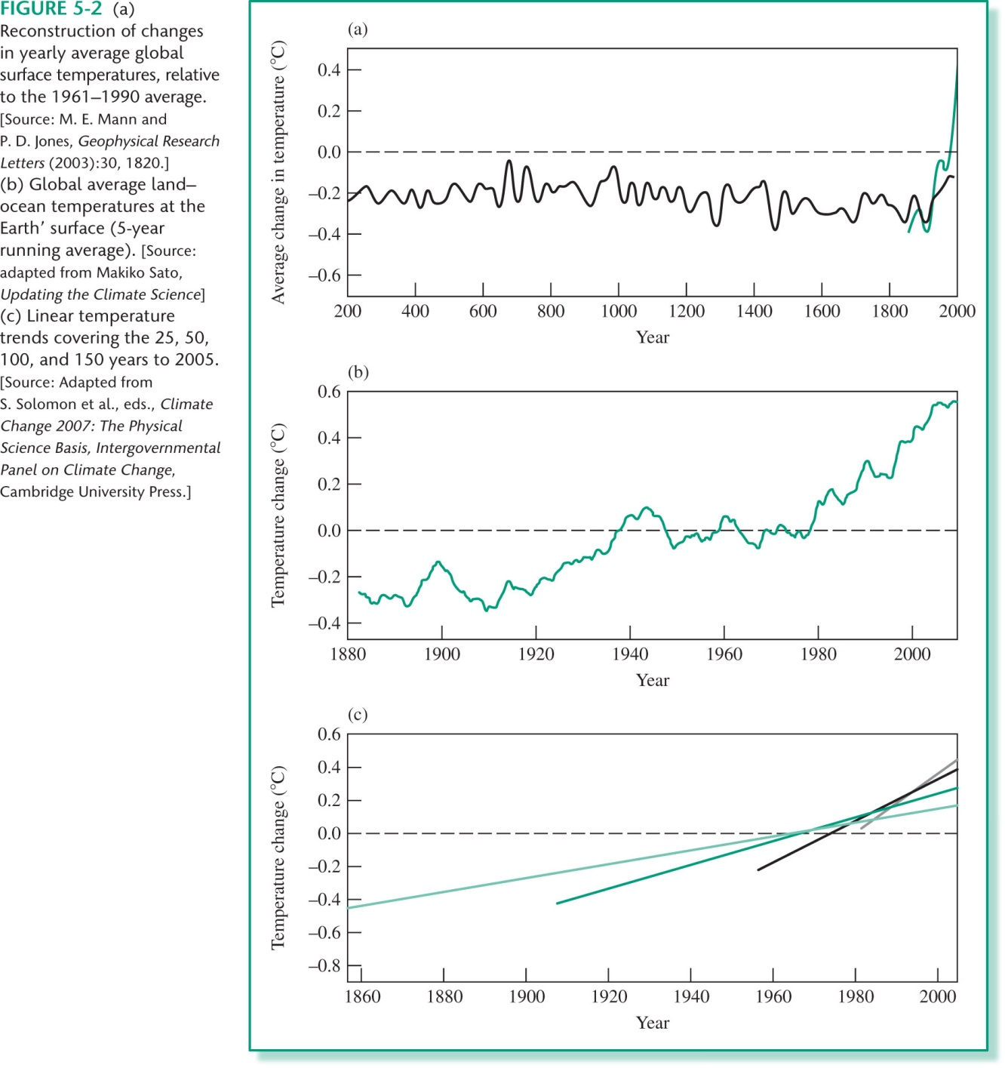
Historical temperature trends

Slide 3
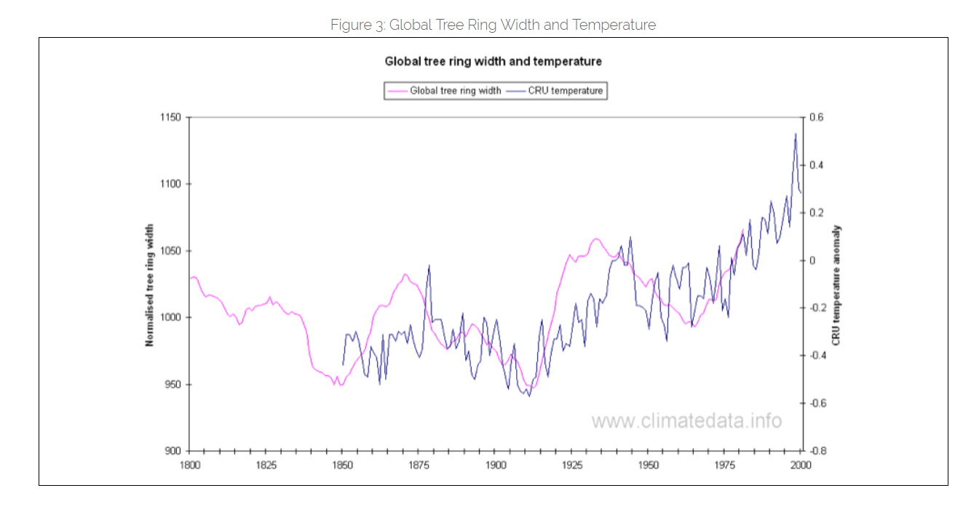

Slide 4

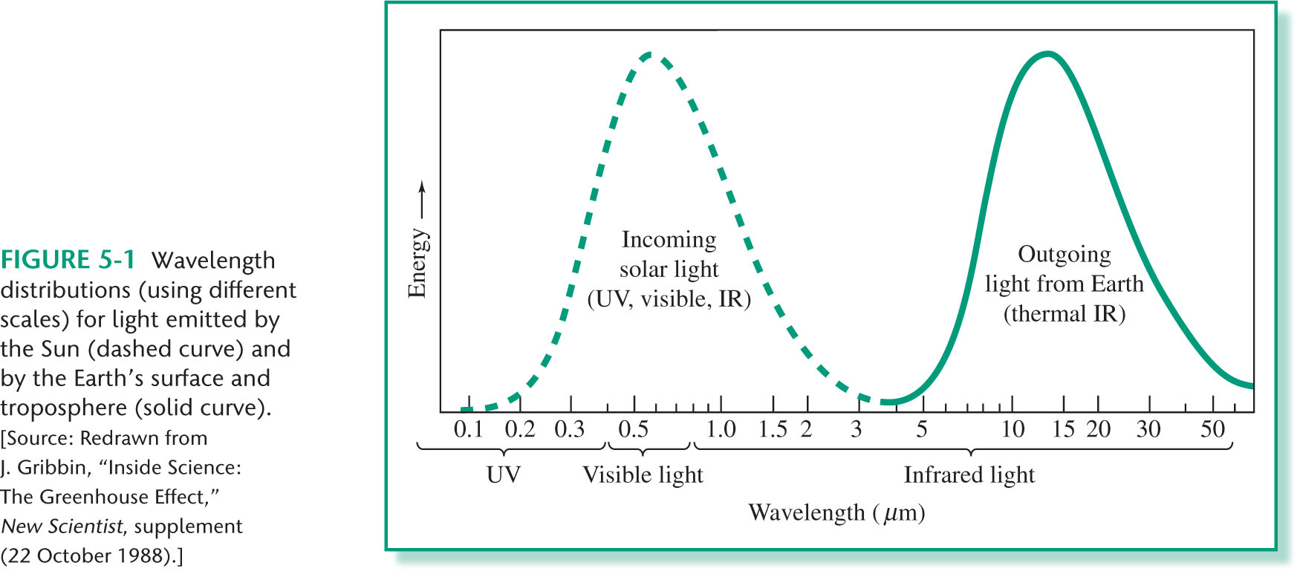
Greenhouse effect

Slide 5
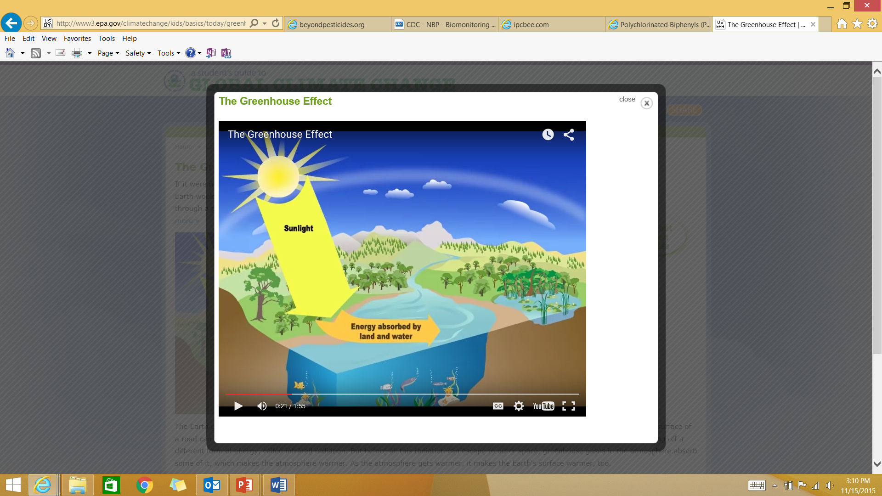
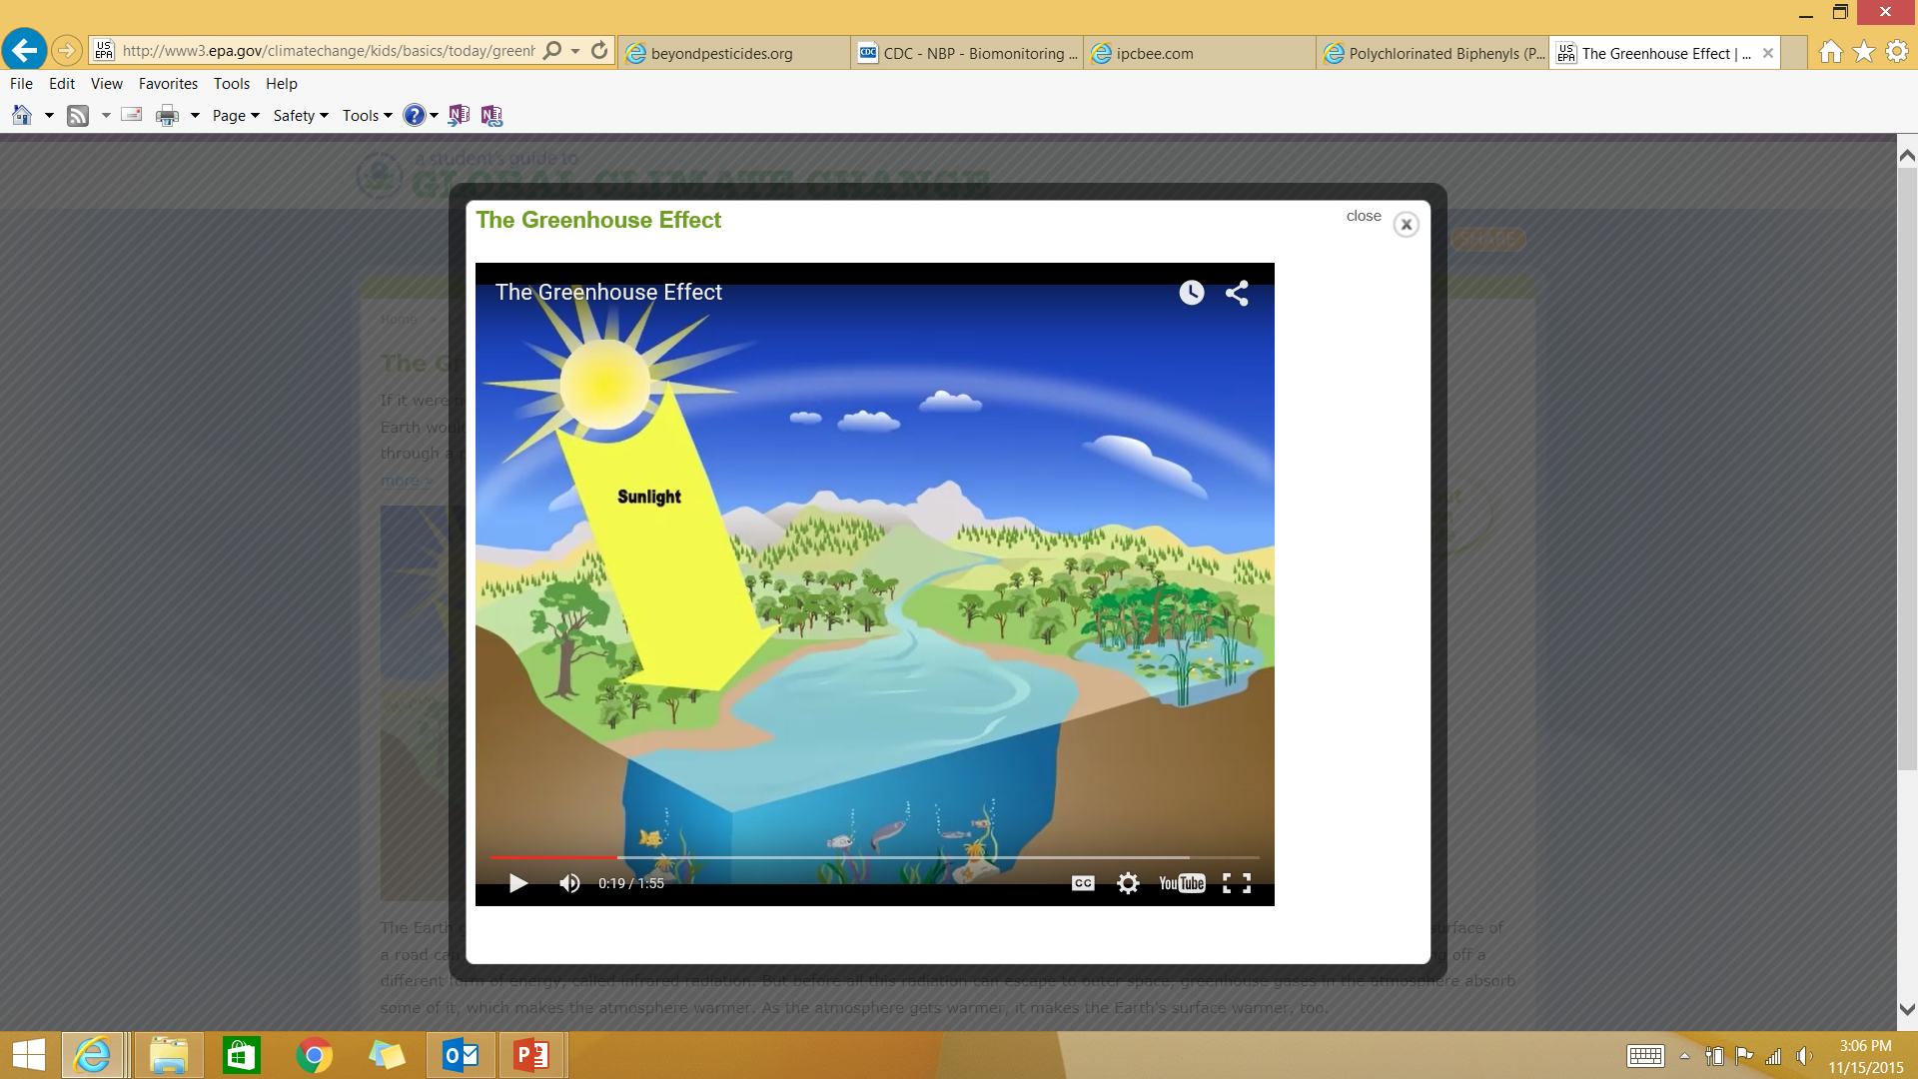
Greenhouse effect

Slide 6
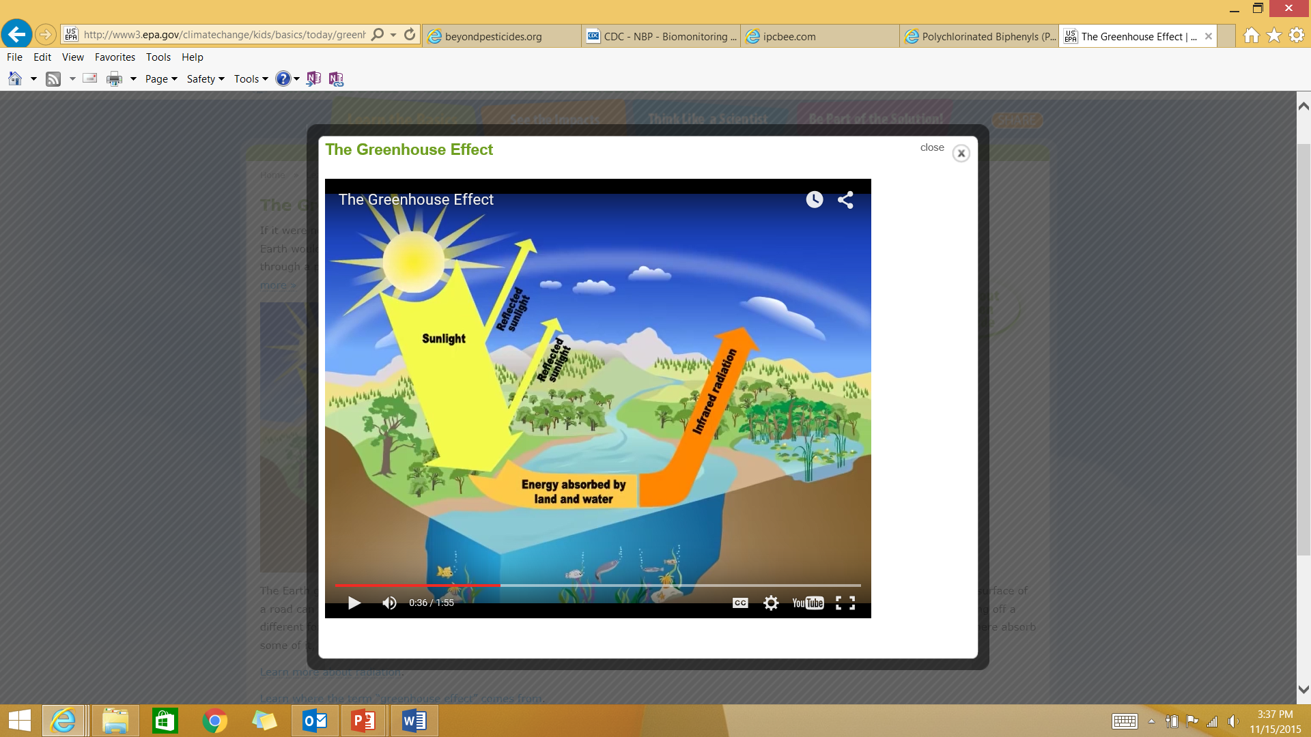
Greenhouse effect

Slide 7
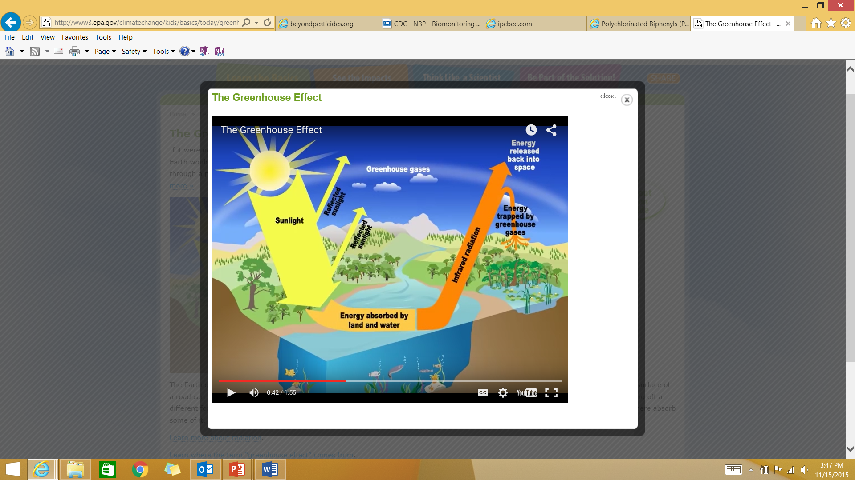
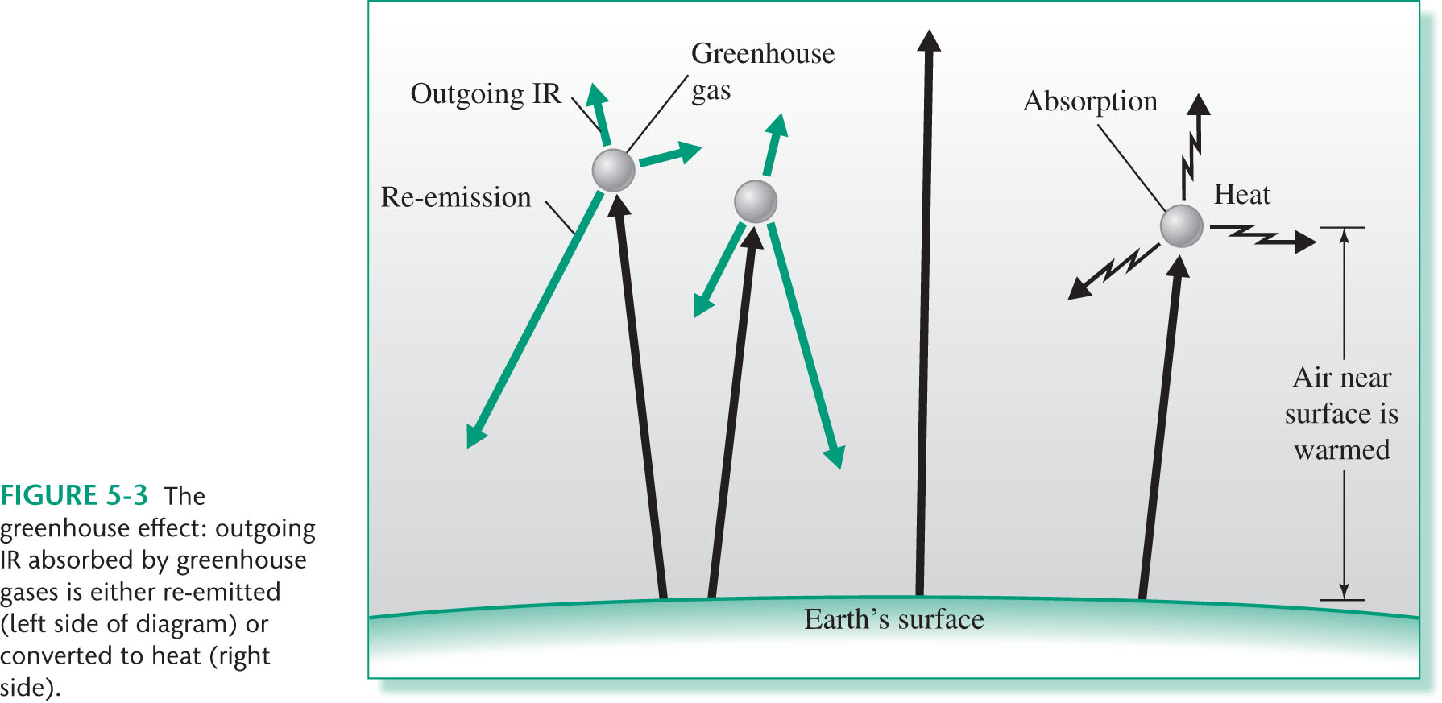
Greenhouse effect

Slide 8

Greenhouse effect

Slide 9
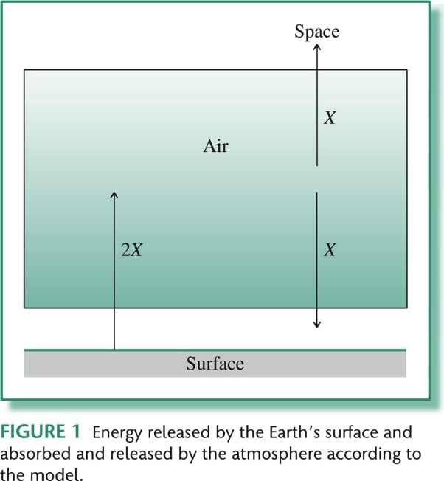
Greenhouse effect Models
Single-layer Model
Multilayer Model
Radiative Models
Radiative-convective Models
General Circulation Models

Slide 10
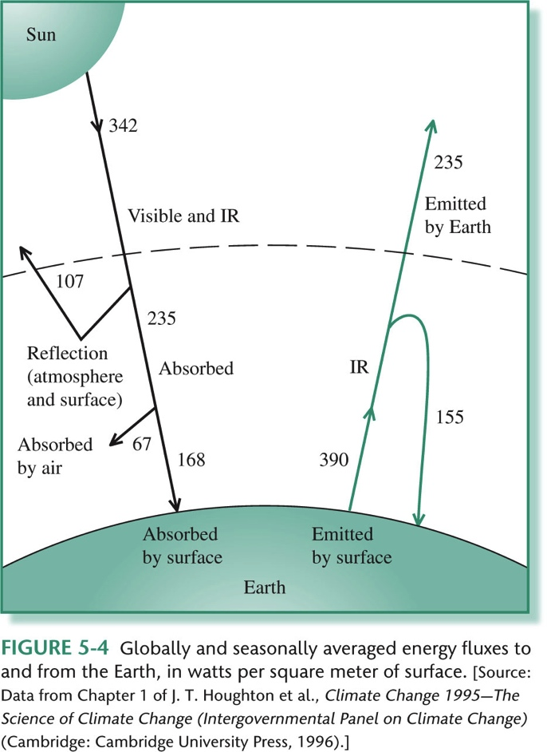
Earth’s Energy Balance

Slide 11
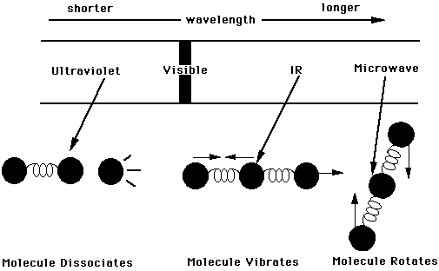
Energy absorption by greenhouse gases

Slide 12
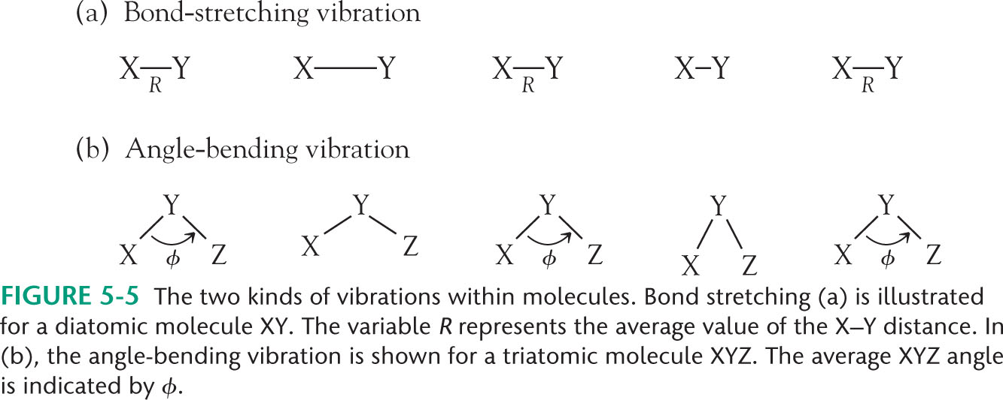
Energy absorption by greenhouse gases
For a particular vibrational mode to be observed (active) in the infrared spectrum, the mode must involve a change in the dipole moment of the molecule

Slide 13
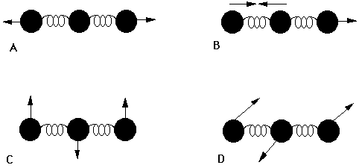
Carbon dioxide
Linear molecule
Number of vibrational modes = 3N-5

Slide 14
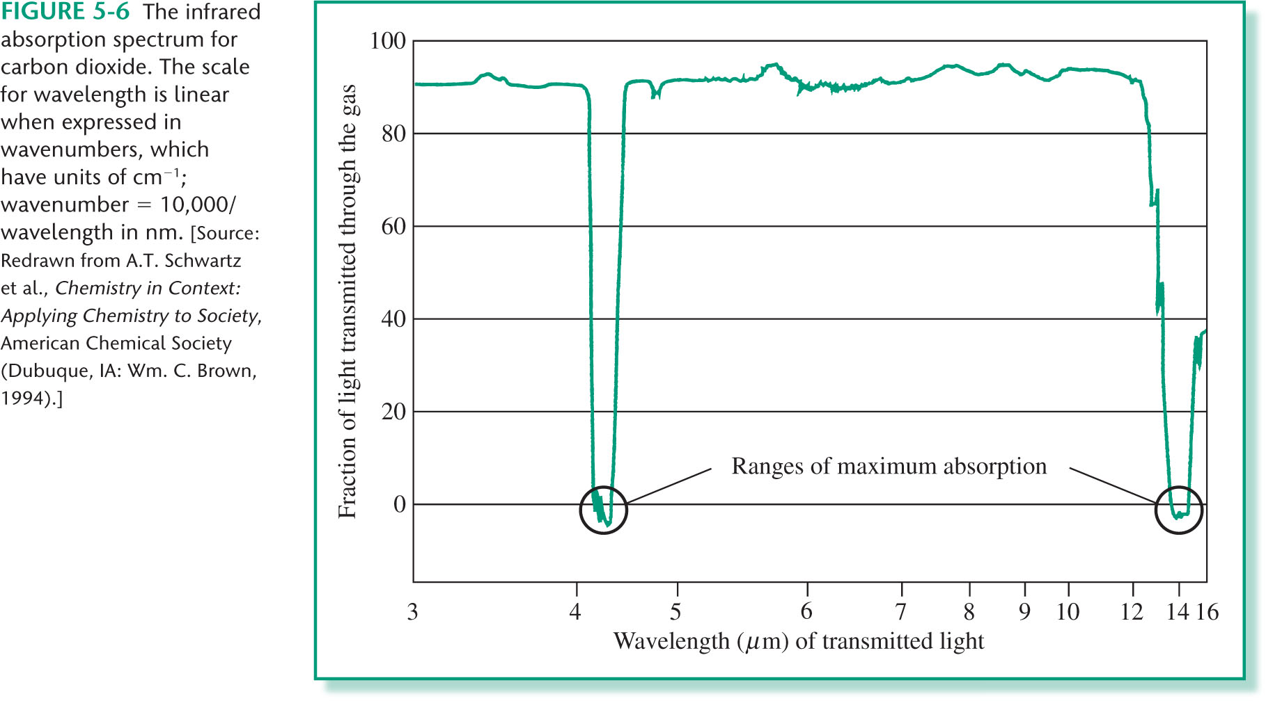
Carbon dioxide

Slide 15
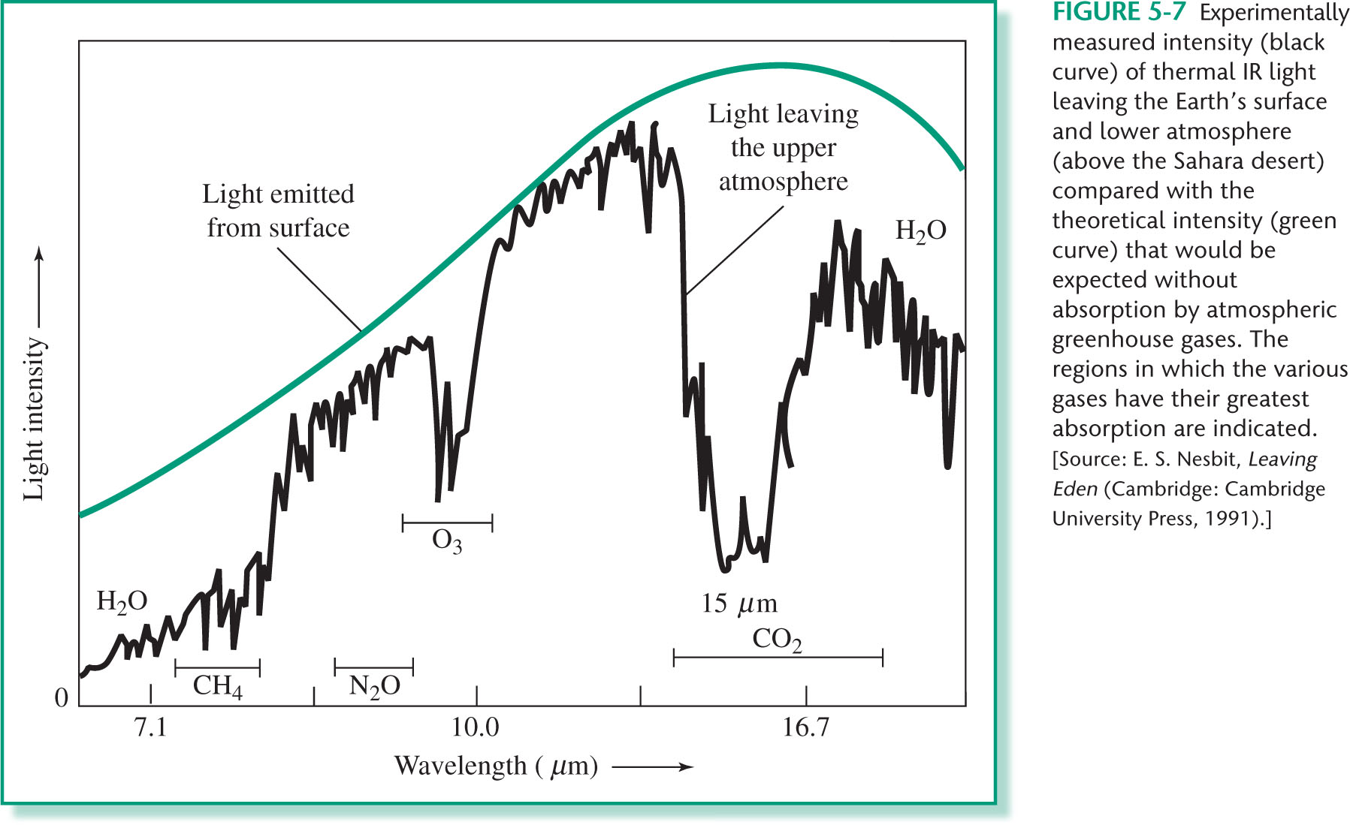
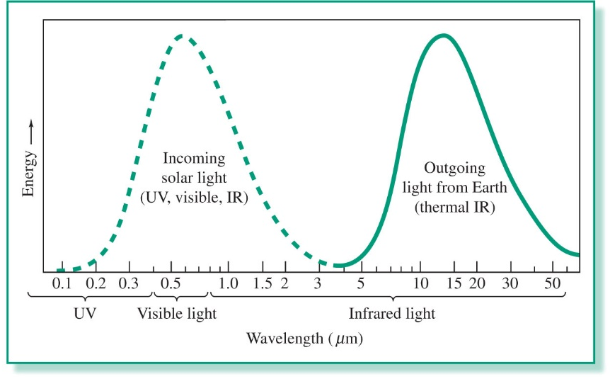
Carbon dioxide

Slide 16
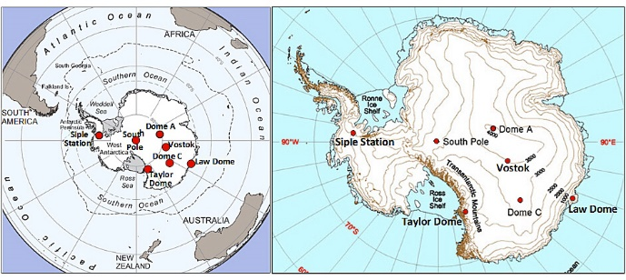
Carbon dioxide
800,000-year Ice-Core Records of Atmospheric Carbon Dioxide (CO₂)
World Data Center for Paleoclimatology, National Oceanic and Atmospheric Administration (NOAA)

Slide 17
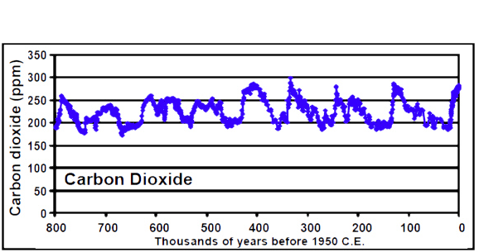
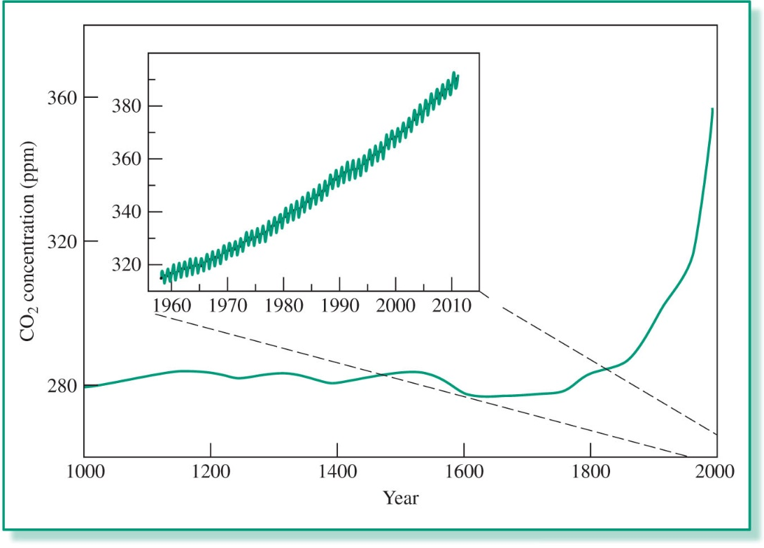
Carbon dioxide
Over the last 800,000 years atmospheric CO₂ levels as indicated by the ice-core data have fluctuated between 170 and 300 parts per million by volume (ppmv), corresponding with conditions of glacial and interglacial periods.
Prior to about 450,000 years before present time (BP) atmospheric CO₂ levels were always at or below 260 ppmv and reached lowest values, approaching 170 ppmv, between 660,000 and 670,000 years ago. The highest pre-industrial value recorded in 800,000 years of ice-core record was 298.6 ppmv, in the Vostok core, around 330,000 years ago.
Atmospheric CO₂ levels have increased markedly in industrial times; measurements in year 2010 at Cape Grim Tasmania and the South Pole both indicated values of 386 ppmv, and are currently increasing at about 2 ppmv/year.

Slide 18
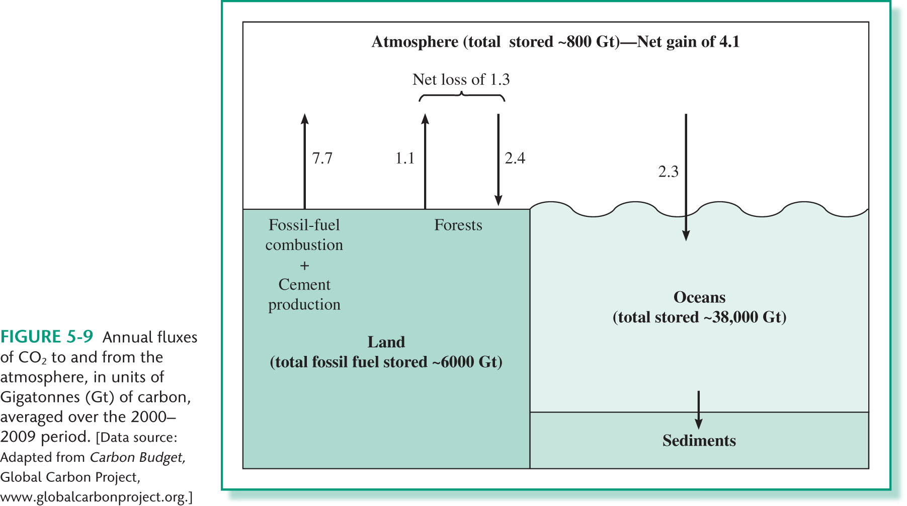
Carbon dioxide

Slide 19
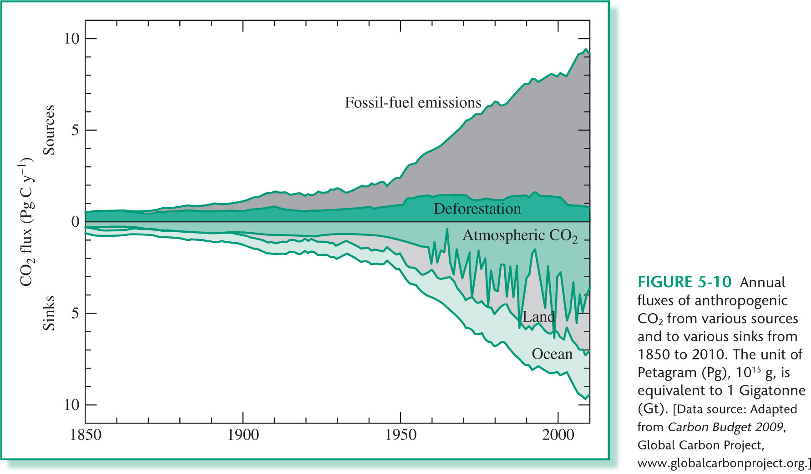
Carbon dioxide

Slide 20
Carbon dioxide
Atmospheric lifetime
1990 study: 50 to 200 years
1995 and 2001 studies: 5 to 200 years
2007 report:
"About 50% of a CO₂ increase will be removed from the atmosphere within 30 years, and a further 30% will be removed within a few centuries. The remaining 20% may stay in the atmosphere for many thousands of years."
(nature reports climate change | VOL 2 | DECEMBER 2008 | www.nature.com/reports/climatechange )

Slide 21
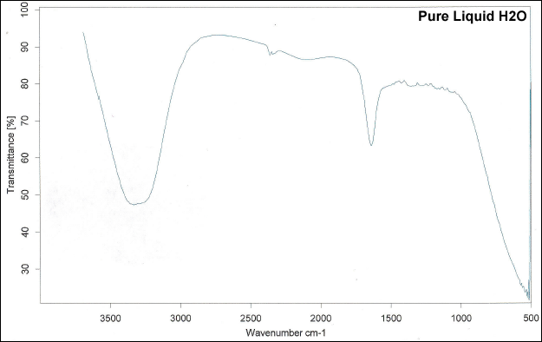
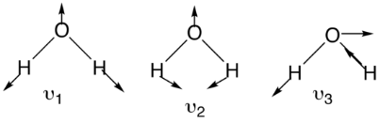
Water vapor
Nonlinear molecule
Number of vibrational modes = 3N-6

Slide 23
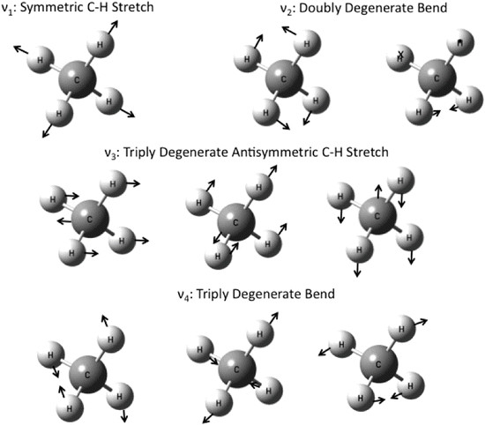
Methane
Nonlinear molecule
Number of vibrational modes = 3N-6
Methane vibrational normal modes http://www.researchgate.net/figure/278652214_fig4_Figure-18-18-Methane-vibrational-normal-modes

Slide 24
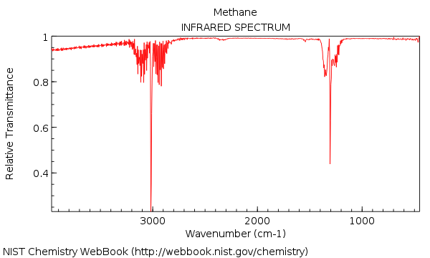
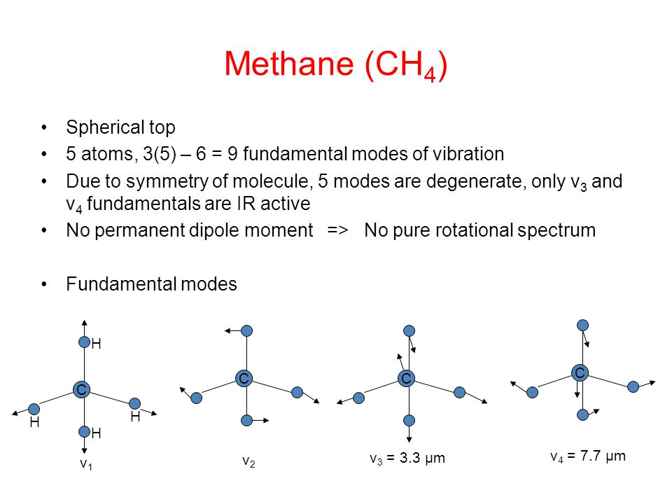
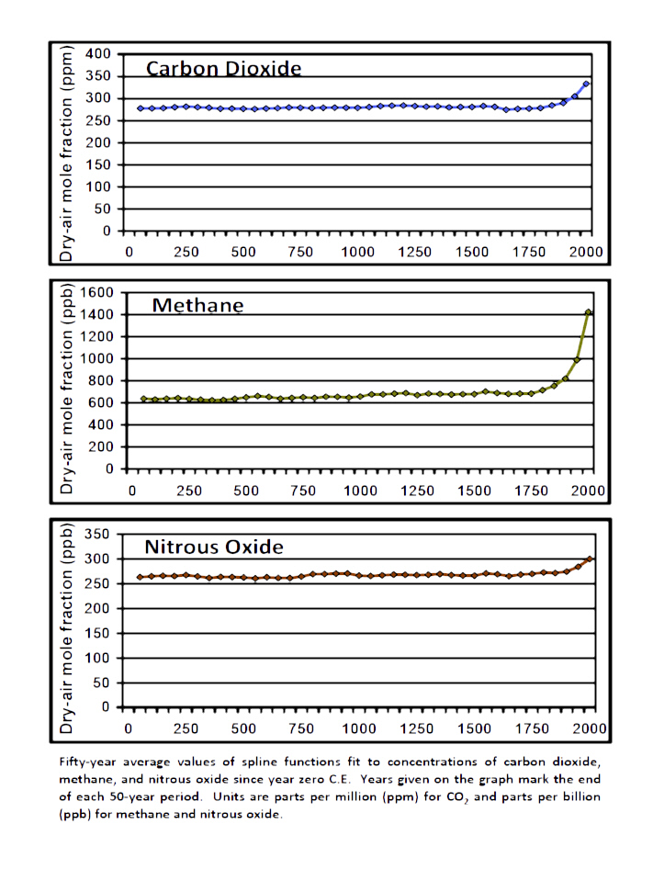
Methane

Slide 25
Methane
Lifetime less than a decade
Sinks:
Loss from air
Soil
Loss to the stratosphere
Sources
Anaerobic decomposition of organic matter
- natural wetlands
- flooding of land
- landfills
Burning of biomass
Ruminant animals

Slide 26
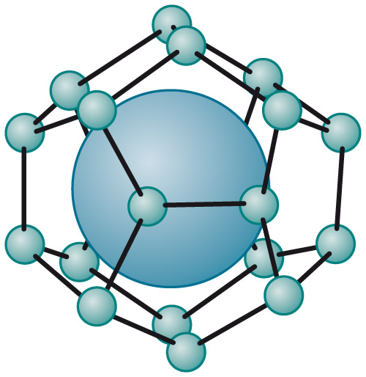
Methane Hydrate

Slide 27
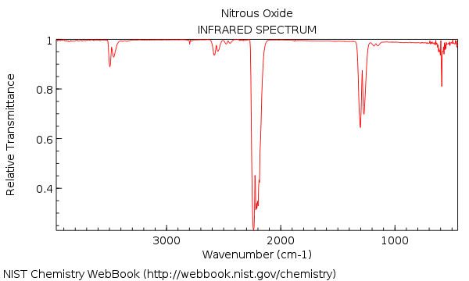
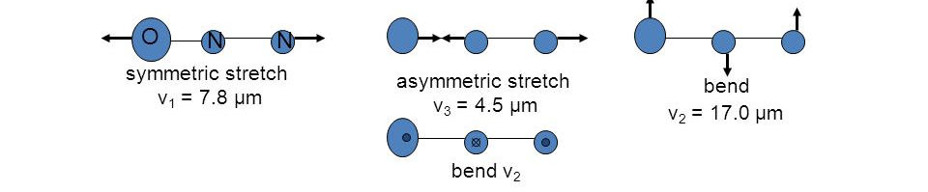
Nitrous oxide
Linear molecule
Number of vibrational modes = 3N-5

Slide 28
Nitrous oxide

Slide 29
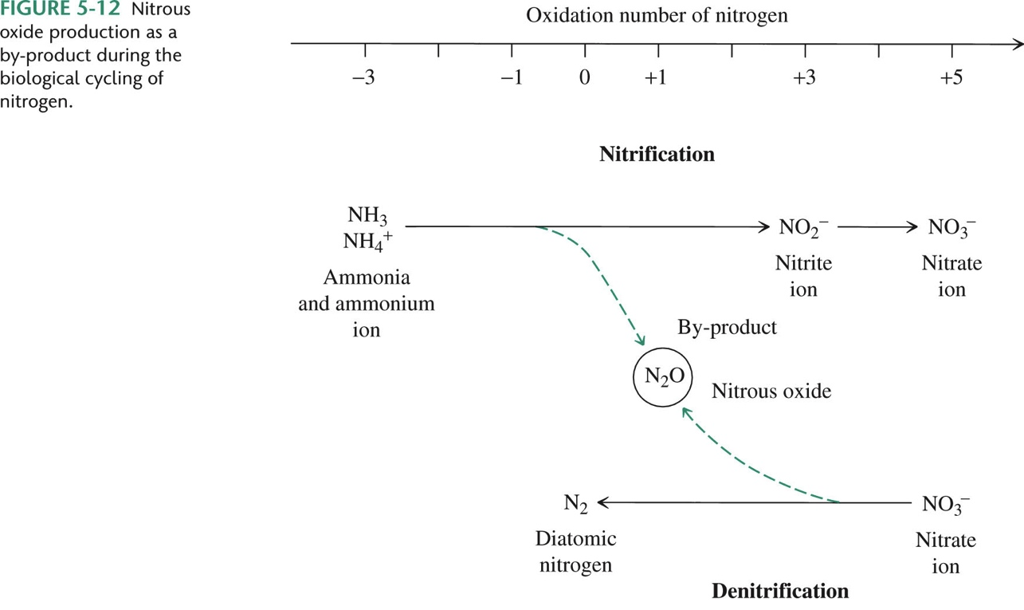
Nitrous oxide

Slide 30
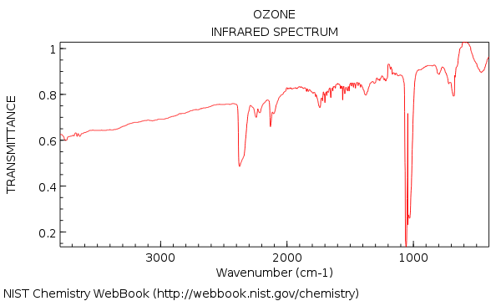
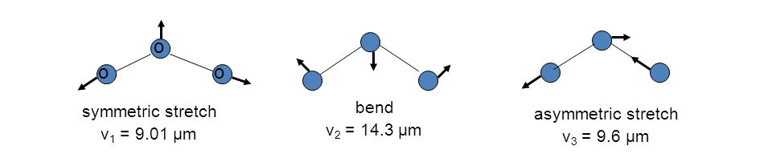
Ozone
Nonlinear molecule
Number of vibrational modes = 3N-6

Slide 32
Record Greenhouse Gas Concentrations in the Atmosphere WMO Global Atmosphere Watch
Levels of the main long-lived greenhouse gases, carbon dioxide (CO₂), methane (CH₄)) and nitrous oxide (N₂O) have reached new highs.
The last time Earth’s atmosphere contained 400 parts per million CO₂ was about 3-5 million years ago, when global mean surface temperatures were 2-3°C warmer than today, ice sheets in Greenland and West Antarctica melted, parts of East Antarctica ice had retreated, all causing global see level rise of 10-20m compared with today.
In 2018, global CO₂ concentration was 407.8 parts per million (ppm), 2.2 ppm higher than 2017. Preliminary data from a subset of greenhouse gas monitoring sites for 2019 indicate that CO2 concentrations are on track to reach or even exceed 410 parts per million (ppm) by the end of 2019.
In 2017, globally averaged atmospheric concentrations of CO₂ were 405.6 ±0.1 ppm, CH₄) at 1859 ±2 parts per billion (ppb) and N₂O at 329.9 ±0.1 ppb. These values constitute, respectively, 146%, 257% and 122% of pre-industrial levels (pre-1750).
The growth rate of CO₂ averaged over three consecutive decades (1985–1995, 1995–2005 and 2005–2015) increased from 1.42 ppm/yr to 1.86 ppm/yr and to 2.06 ppm/yr
https://www.ipcc.ch/2019/

Slide 33
Aerosols
Collection of particulates, whether solid particles or liquid droplets, dispersed in air
Aerosol particles are emitted from Earth's surface both naturally (e.g., dust, sea-salt, biogenic emissions), and as a result of human activities.

Slide 34
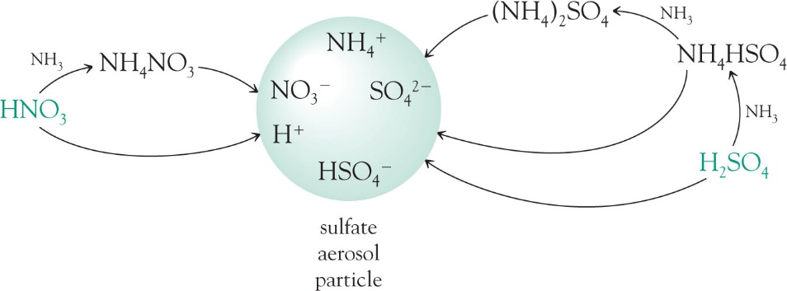
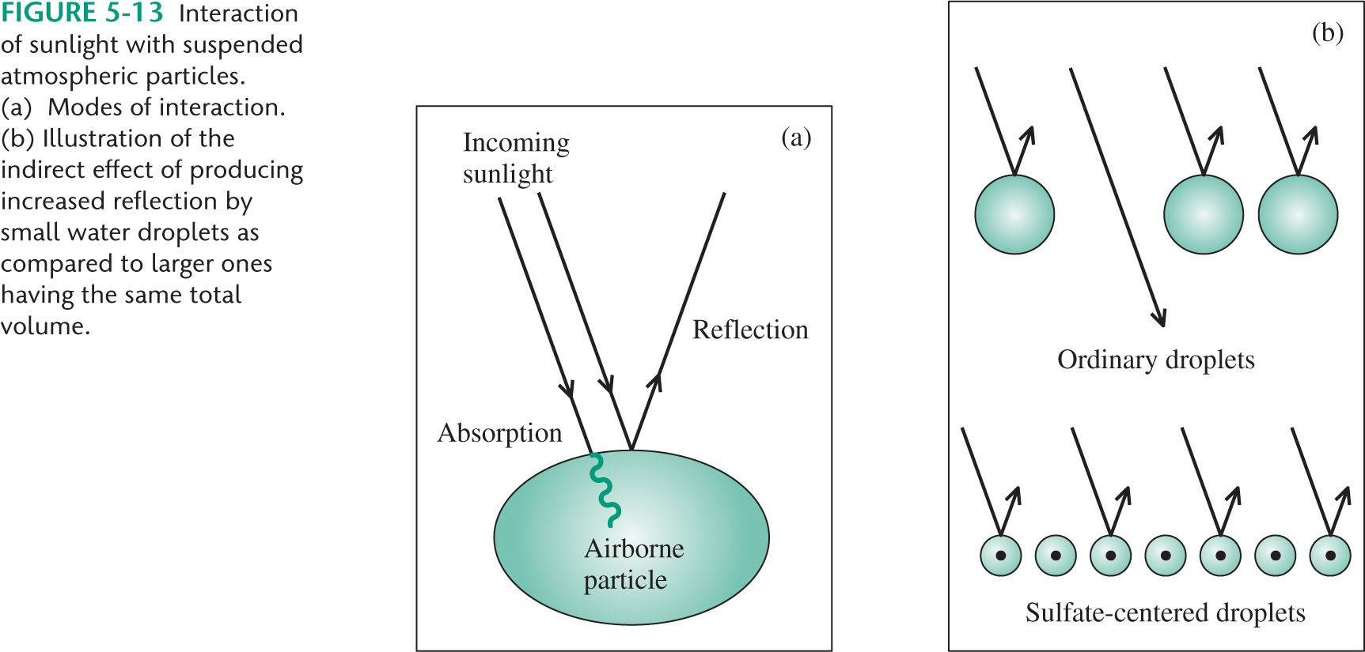
Aerosols
They have an effect on the energy balance of the atmosphere either by directly scattering and absorbing radiation, by serving as condensation nuclei during cloud formation, and by influencing precipitation.

Slide 35
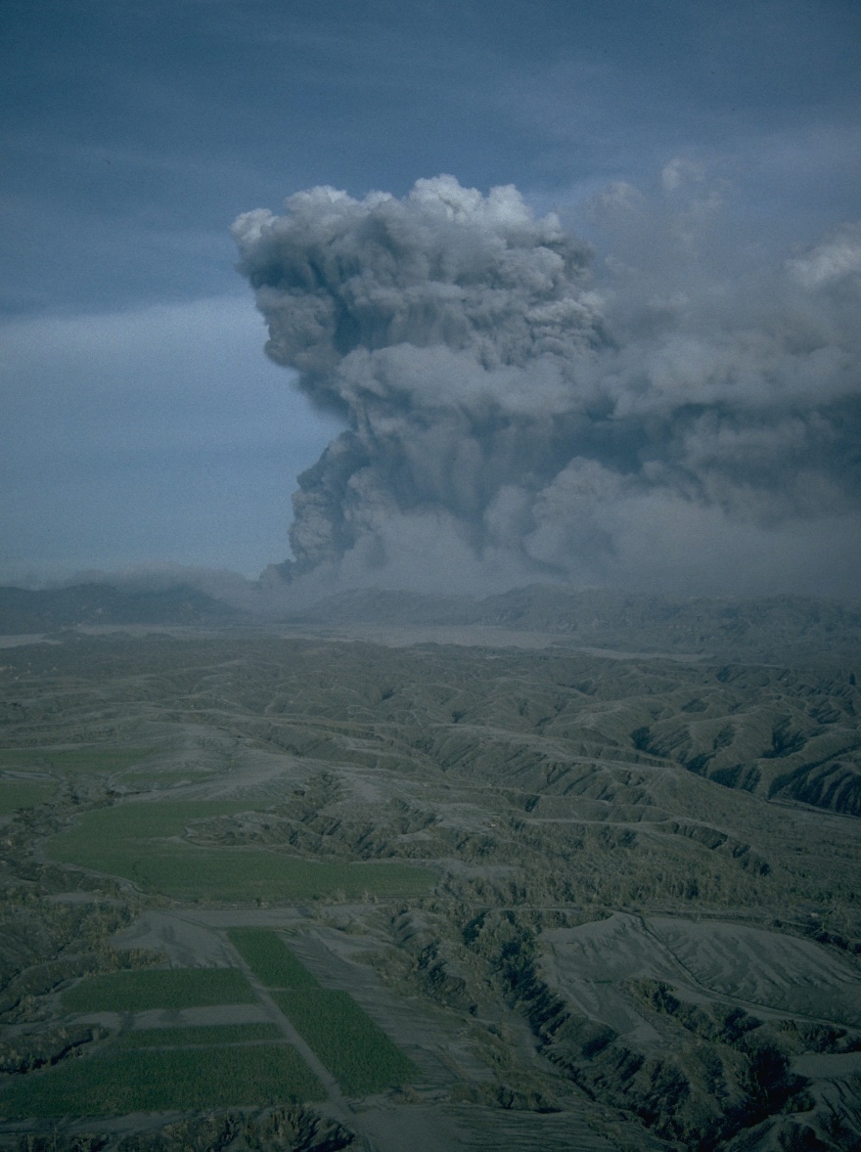
Aerosols
The climactic eruption of Mount Pinatubo on June 15, 1991, was one of the largest eruptions of the twentieth century and injected a 20-million ton (metric scale) sulfur dioxide cloud into the stratosphere at an altitude of more than 20 miles.
The Pinatubo cloud was the largest sulfur dioxide cloud ever observed in the stratosphere since the beginning of such observations by satellites in 1978.
It caused cooled the Earth's surface for three years following the eruption, by as much as 1.3 degrees at the height of the impact.

Slide 36
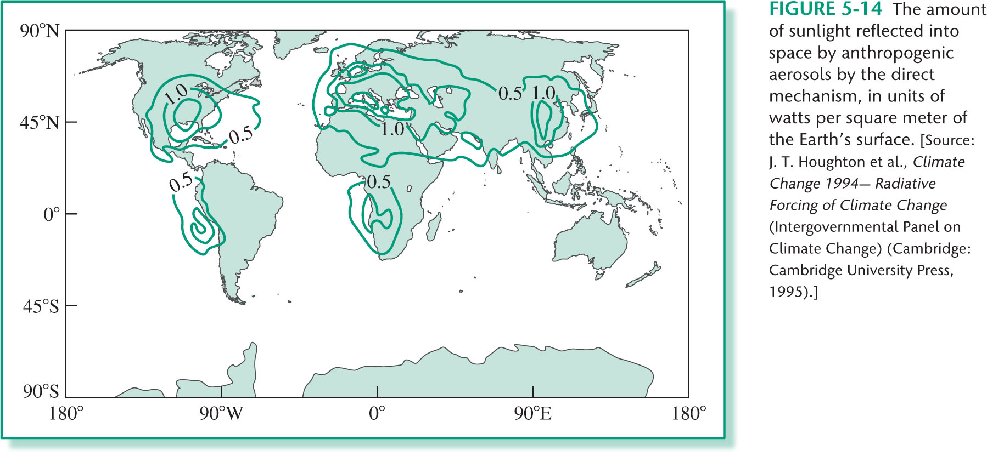
Aerosols

Slide 37
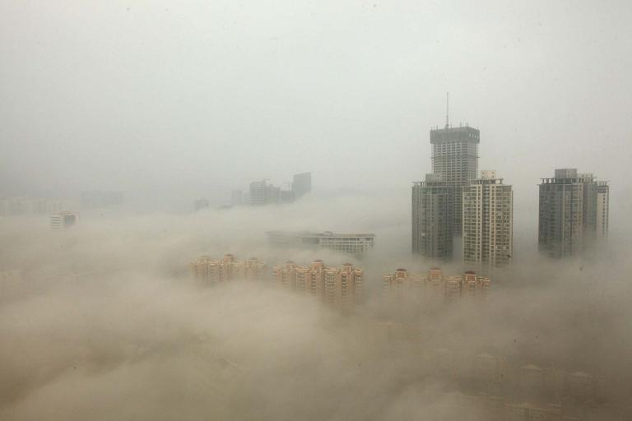
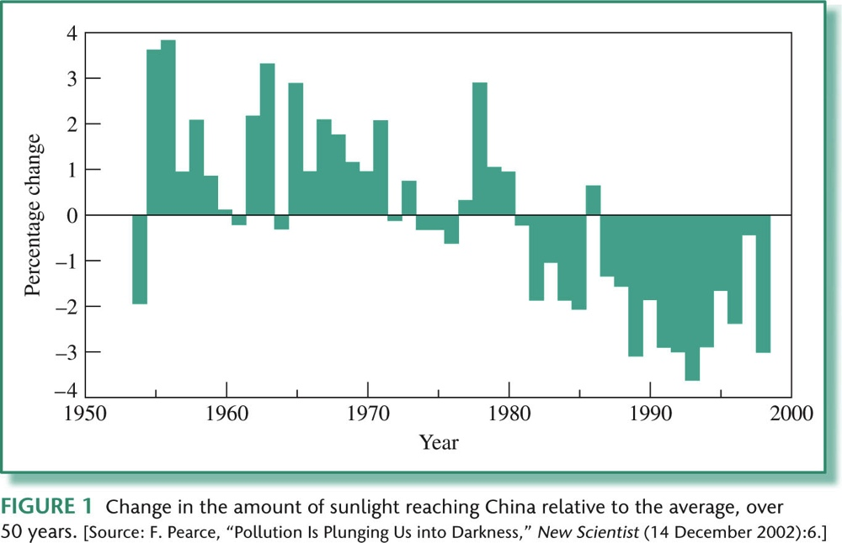
Aerosols

Slide 38
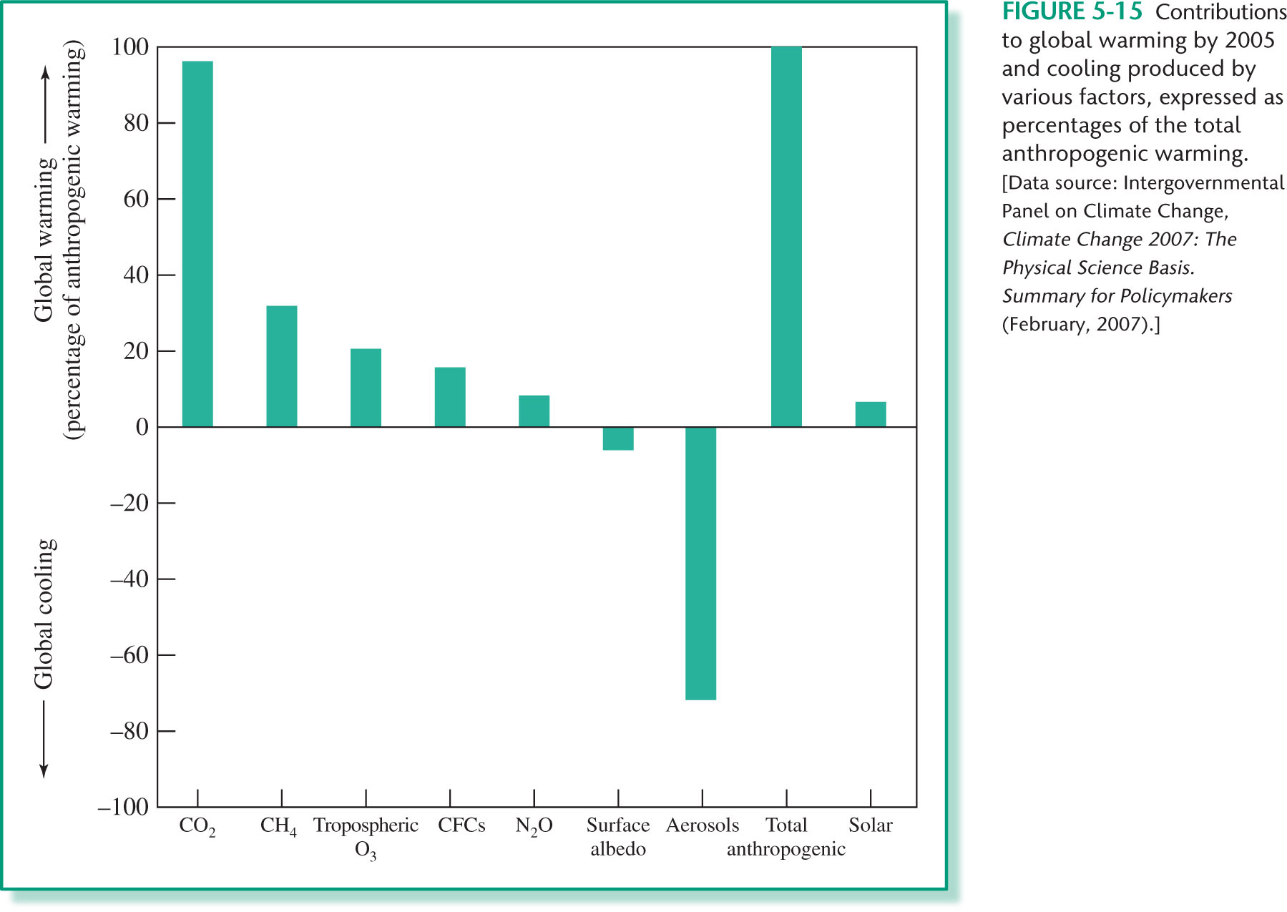
Global Warming

Slide 39
Global Warming

Slide 40
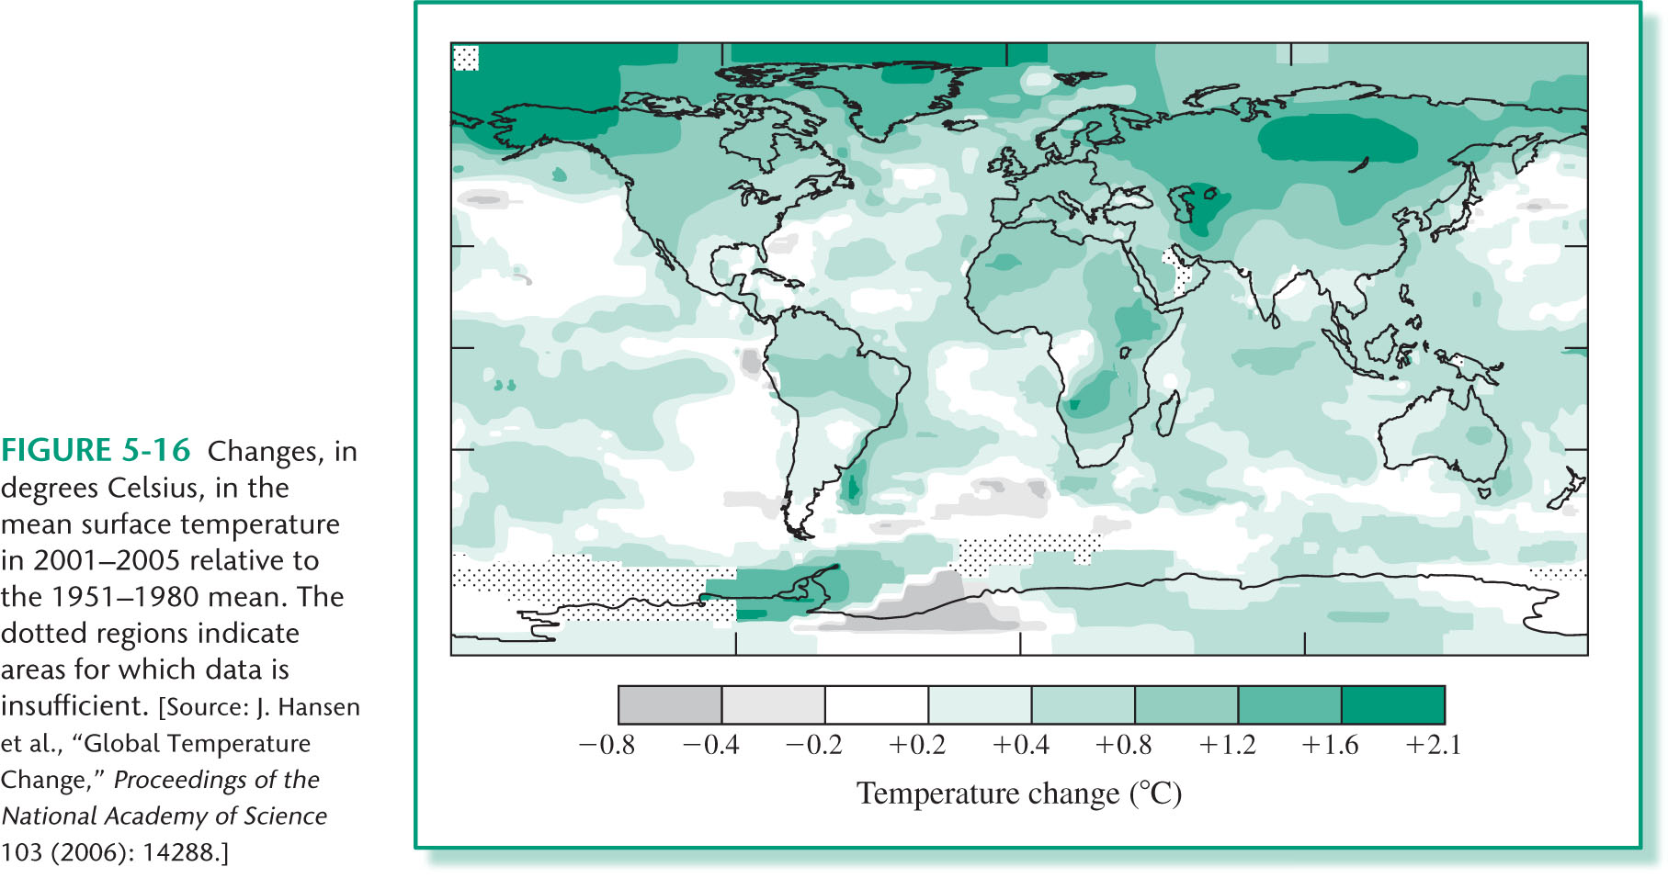
Global Warming

Slide 41
Global Warming

Slide 42
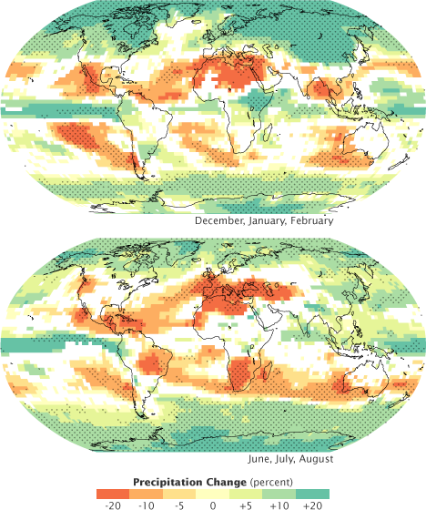
Climate Change
Precipitation has increased in most area, but decreased in others
With some exceptions, the tropics will likely receive less rain (orange) as the planet warms, while the polar regions will receive more precipitation (green). White areas indicate that fewer than two-thirds of the climate models agreed on how precipitation will change. Stippled areas reveal where more than 90 percent of the models agreed.
http://earthobservatory.nasa.gov

Slide 43
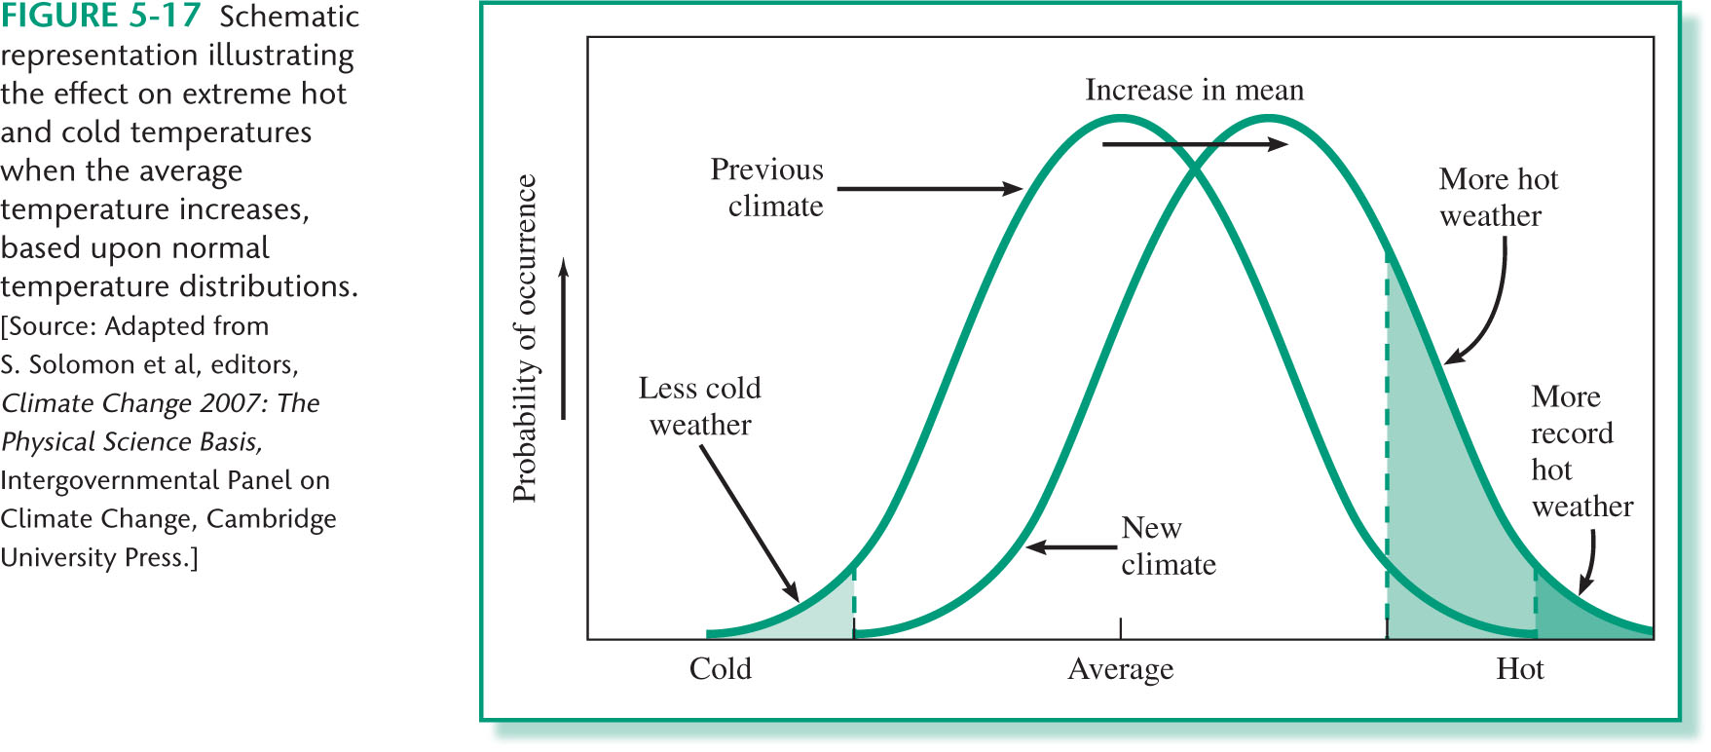
Climate Change
Extreme weather is becoming more common.

Slide 44
Climate Change
Winters have become shorter, by about 11 days
Earth’s ice cover is shrinking fast
Warming water is killing much of the coral in ocean reefs and threatening sea life
Mosquito-borne diseases have reached higher altitudes
Rising seas are threatening to engulf Pacific Islands

Slide 45
The Global Climate in 2015-2019
Warmest five-year period on record
The average global temperature for 2015–2019 is on track to be the warmest of any equivalent period on record. It is currently estimated to be 1.1°Celsius (± 0.1°C) above pre-industrial (1850–1900) times. Widespread and long-lasting heatwaves, record-breaking fires and other devastating events such as tropical cyclones, floods and drought have had major impacts on socio-economic development and the environment.
Continued decrease of sea ice and ice mass
Arctic summer sea-ice extent has declined at a rate of approximately 12% per decade during 1979-2018. The four lowest values for winter sea-ice extent occurred between 2015 and 2019. Overall, the amount of ice lost annually from the Antarctic ice sheet increased at least six-fold between 1979 and 2017. Glacier mass loss for 2015-2019 is the highest for any five-year period on record.
Sea-level rise is accelerating, sea water is becoming more acidic
The observed rate of global mean sea-level rise accelerated from 3.04 millimeters per year (mm/yr) during the period 1997–2006 to approximately 4mm/yr during the period 2007–2016. This is due to the increased rate of ocean warming and melting of the Greenland and West Antarctica ice sheets. There has been an overall increase of 26% in ocean acidity since the beginning of the industrial era.

Slide 46
Geoengineering Earth’s Climate
Solar Radiation Management
Reflecting a small fraction of the sunlight headed toward Earth back into space
Carbon Dioxide Removal
Removing carbon dioxide from ambient air, and storing it.
Earth Radiation Management
Increasing the heat transfer to outer space
To date, no geoengineering method has been attempted on a significant scale.

Slide 47
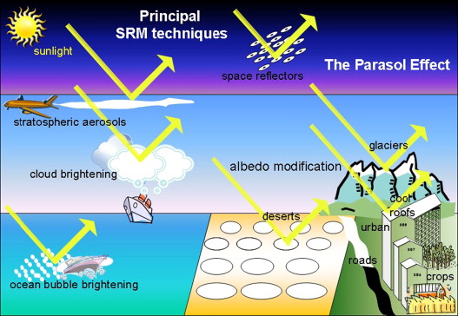
Solar radiation management

Slide 48
Solar radiation management Space projects
giant mirrors (55,000 orbiting mirrors each of 100 km²) made of wire mesh
trillions of light and small mirrors (the size of a DVD), in order to deflect sunlight back to space
deflector of 1400-km diameter at the first Lagrange Point, manufactured and launched from the Moon
mine the moon to create a shielding cloud of dust
This option is widely considered unrealistic, as the expense is prohibitive, the potential of unintended consequences is huge and a rapid reversibility is not granted.

Slide 49
Solar radiation management Stratospheric aerosols
Artificially increase the concentration of the microscopic sulfate aerosols particles in the lower stratosphere to deflect an additional fraction of sunlight (2%) of incoming sunlight.
inspired by studies of the Mount Pinatubo volcano eruption
Few TG of sulfur per year would counter the global warming effect due to doubling the CO₂.
- special aircrafts
- artillery guns
- balloons

Slide 50
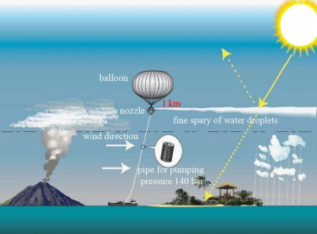
The SPICE (stratospheric particle injection for climate engineering) consisted in using a small hose-augmented balloon up just over one km high, pumping water into the air. The aim was to test the feasibility of later piping sulfates at 25 km high .

Slide 51
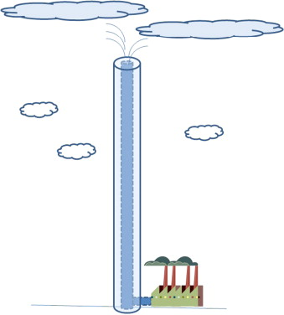
Multi-kilometer height tall towers with a 15–50 km high altitude duct “conduit” for the aerosol injection in the stratosphere.

Slide 52
Solar radiation management Stratospheric aerosols
Continuous supply
Full-scale implementation
Less expensive than space projects
Negative consequences:
- reduction in regional rainfall
- decrease in stratospheric ozone

Slide 53
Solar radiation management

Slide 54
Solar radiation management Atmospheric projects
Cloud Brightening
Sea water can be pumped up and sprayed into the air to increase the number of droplets, and produce fine sea salt crystals increasing the reflectivity of low altitude clouds.
Many droplets and salt aerosols are expected to make whiter clouds and reflect more intensity of sunlight.

Slide 55
Solar radiation management Ground-level projects
Increasing Earth’s albedo
painting roofs and paved roads white
covering glaciers and deserts with reflective plastic sheeting
putting white or pale-colored plastic floating panels over oceans or lakes
planting genetically engineered paler crops

Slide 56
Solar radiation management Ground-level projects
In 2005 a small pilot project on the Gurschen glacier of the Swiss Alps was conducted to try to stop the ice melting of glaciers with a “ice protector” textile made of a lightweight dual-layer composite with polyester in the top side to reflect light, and polypropylene on the bottom to block heat and slow ice melting during the summer. It proved successful as the blanketed area had 80% less melt than surrounding ice.
In the Peru Andean region, a local team that painted rocks in white won a $200,000 prize from the World Bank as part of its “100 Ideas to Save the Planet” competition.

Slide 57
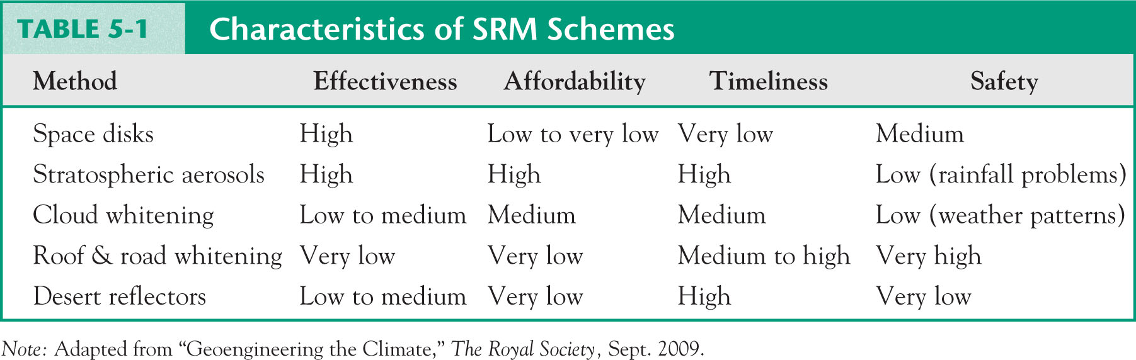
Solar radiation management

Slide 58
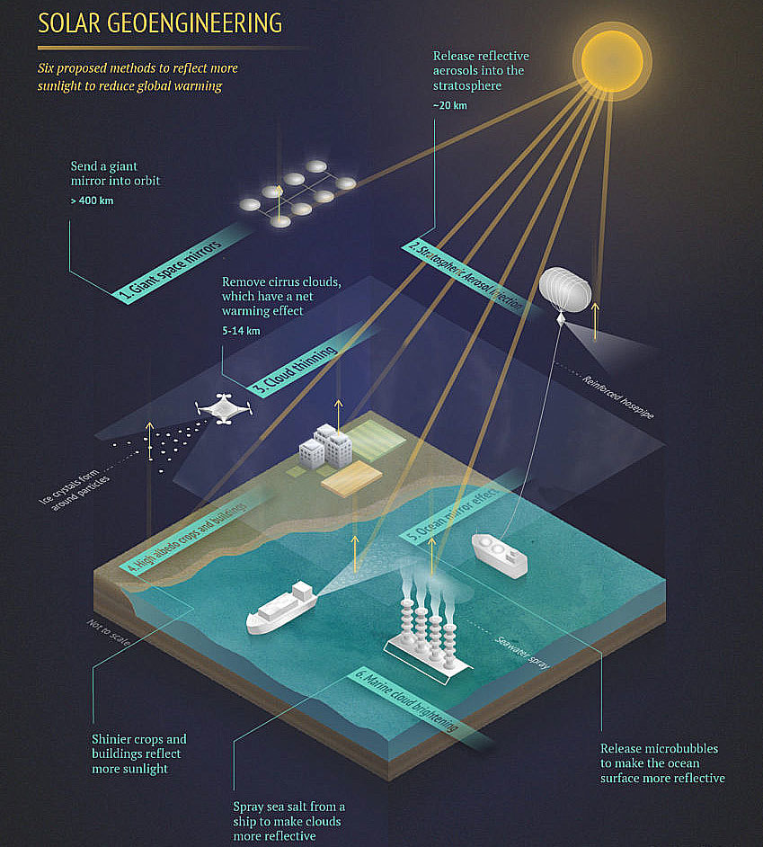
Solar radiation management

Slide 59
Solar radiation management
https://www.youtube.com/watch?v=WR6uSXW-8p4

Slide 60
Geoengineering Earth’s Climate
Solar Radiation Management
Reflecting a small fraction of the sunlight headed toward Earth back into space
Carbon Dioxide Removal
Removing carbon dioxide from ambient air, and storing it.
Earth Radiation Management
Increasing the heat transfer to outer space
To date, no geoengineering method has been attempted on a significant scale.

Slide 61
Geoengineering Earth’s Climate
Carbon dioxide (CO₂) capture and sequestration is a three-step process that includes:
Capture of CO₂
Transport of the captured and compressed CO₂
Sequestration

Slide 62
Geoengineering Earth’s Climate
Capture of CO₂
From coal, gas-power plants, large industrial plants
- post-combustion
- pre-combustion
From air
- direct air capture
https://www.youtube.com/watch?v=XHX9pmQ6m_s

Slide 63
Geoengineering Earth’s Climate
Carbon dioxide (CO₂) capture and sequestration (CCS) is a three-step process that includes:
Capture of CO₂
Transport of the captured and compressed CO₂
Sequestration

Slide 64
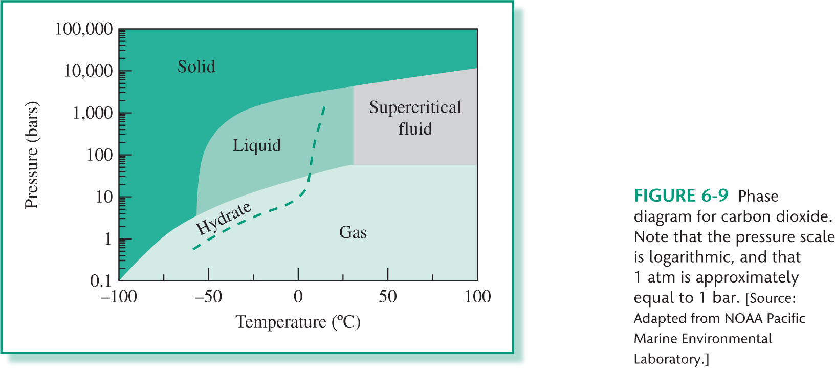
Sequestration
Carbon Dioxide

Slide 65
Sequestration
Ocean
- acidic, neutral, fertilization
Terrestrial environments
- vegetation, soils, sediments
Geologic formations
- depleted oil and gas fields, deep coal seems, saline formation, porous rock

Slide 66
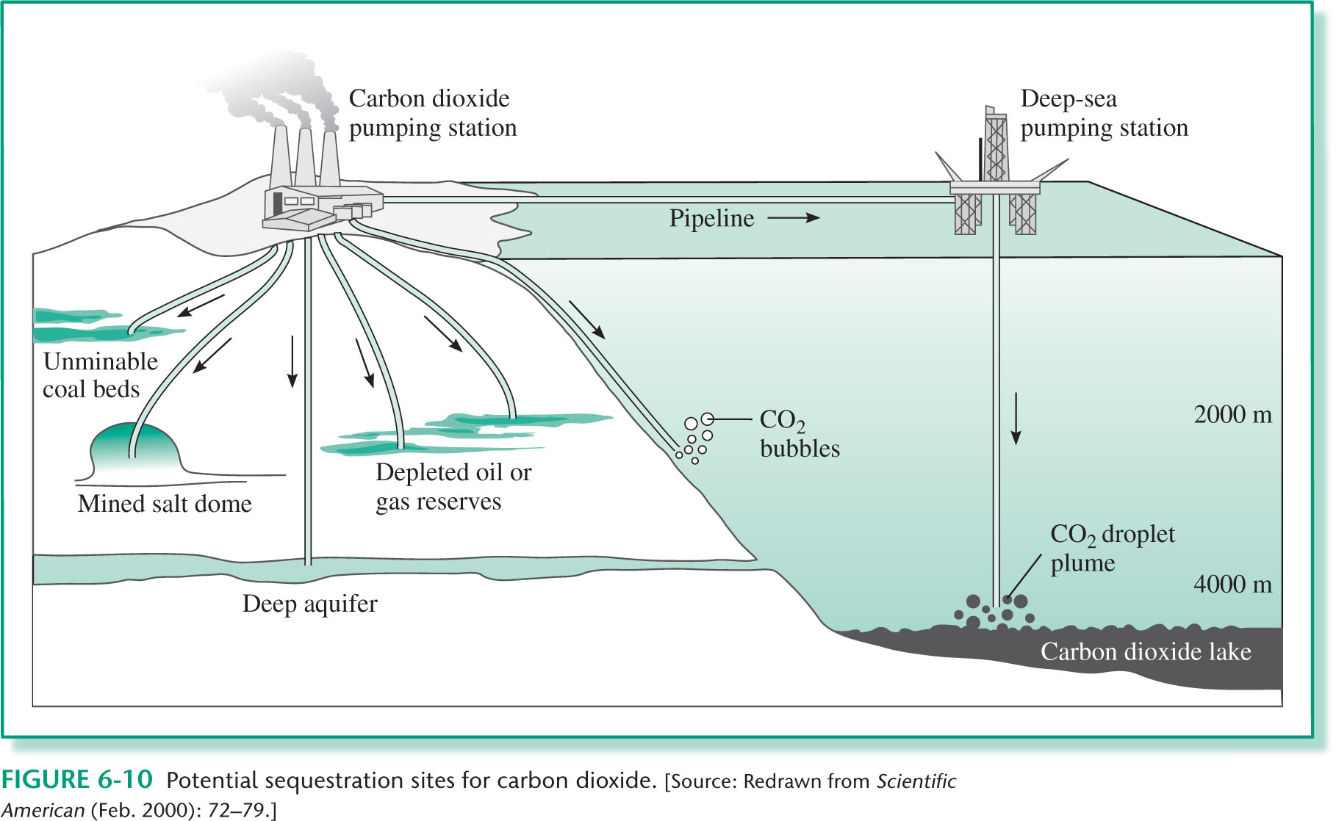
Sequestration

Slide 67

Sequestration
Geological

Slide 68

Sequestration
Geological

Slide 69
CO₂ emissions in the future
Emission per unit of energy
coal > oil > gas >> renewable and nuclear energy
Carbon intensity
Economy
Energy
Carbon footprint

Slide 70
CO₂ emissions in the future
Emission per unit of energy
coal > oil > gas >> renewable and nuclear energy
Carbon intensity
Economy
Energy
Carbon footprint
Per Capita

Slide 71
CO₂ emissions in the future
Intergovernmental Panel on Climate Change
https://www.ipcc.ch/2019/
Predictions (2100)
CO₂ 500-900 ppm
Temperature 1.4 to 4°C
Snow and sea-iced areas, Permafrost
Sealevel 30-60 cm or 60-110 cm
Ocean Ecosystem: warming and acidification

